Slide 1
Capstone Project
Bike Sharing Demand Prediction TEAM MEMBERS
Abhishek Singh Rawat Jatin Abhilasha .M

Slide 2
CONTENT
BUSINESS UNDERSTANDING
DATA SUMMARY
FEATURE ANALYSIS
EXPLORATORY DATA ANALYSIS
DATA PREPROCESSING
IMPLEMENTING ALGORITHMS
CHALLENGES
CONCLUSIONS

Slide 3
BUSINESS UNDERSTANDING
Bike rentals have become a popular service in recent years and it
seems people are using it more often. With relatively cheaper
rates and ease of pick up and drop at own convenience is what making this business thrive.
Mostly used by people having no personal vehicles and also to avoid congested public transport which that’s why they prefer rental bikes.
Therefore, the business to strive and profit more, it has to be always ready and supply no. of bikes at different locations, to fulfil the demand.
Our project goal is a pre planned set of bike count values that can be a handy solution to meet all demands.

Slide 4
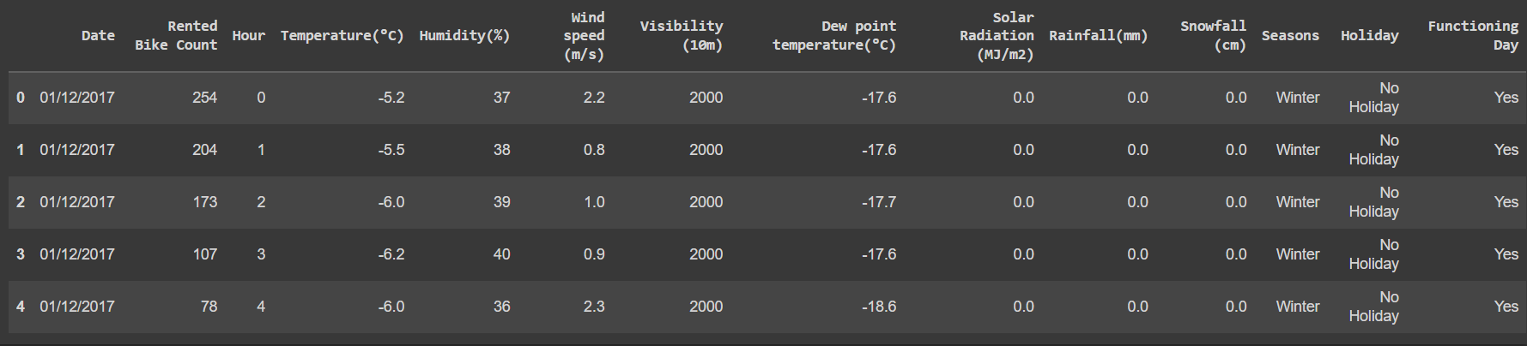
DATA SUMMARY
This Dataset contains 8760 lines and 14 columns.
Three categorical features ‘Seasons’, ‘Holiday’, & ‘Functioning Day’.
One Datetime features ‘Date’
We have some numerical type variables such as temperature, humidity, wind,
visibility, dew point temp, solar radiation, rainfall, snowfall which tells the
environment conditions at that particular hour of the day.

Slide 5
FEATURE SUMMARY
➢ Date : Year-Month-Day
➢ Rented Bike Count - Count of bikes rented at each hour
➢ Hour - Hour of the day
➢ Temperature - Temperature in Celsius
➢ Humidity - %
➢ Wind Speed - m/s
➢ Visibility - 10m
➢ Dew point temperature -Celsius
➢ Solar radiation -MJ/m2
➢ Rainfall -mm
➢ Snowfall -cm
➢ Seasons -Winter, Spring, Summer, Autumn
➢ Holiday -Holiday/No Holiday
➢ Functional Day - NoFunc(Non Functional Hrs),Fun(Functional Hrs)

Slide 6
INSIGHTS FROM OUR DATASET
➢ There are No Missing Values present
➢ There are No Duplicate values present
➢ There are No null values.
➢ And finally we have 'rented bike count' variable which we need to predict
for new observations
➢ The dataset shows hourly rental data for one year (1 December 2017 to 31
November(2018)(365 days).we consider this as a single year data
➢ So we convert the "date" column into 3 different column i.e., “year”,
“month”,“day”.
➢ We change the name of some features for our convenience , they are as
below 'Rented_Bike_Count', 'Hour', 'Temperature', 'Humidity', 'Windspeed’,
'Visibility’,‘Dew_point_temperature', 'Solar_Radiation', 'Rainfall', 'Snowfall’,
'Seasons', 'Holiday’,'Functioning_Day', 'month','weekdays_weekend'

Slide 7
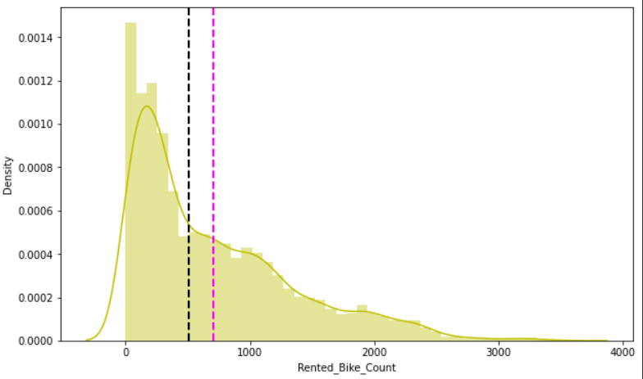
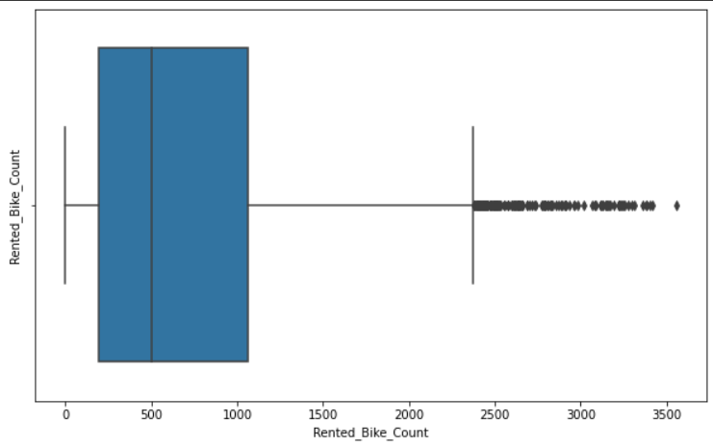
ANALYSIS OF RENTED BIKE COLUMN
➢ The above graph shows that Rented Bike Count has moderate right skewness.
➢ The above boxplot shows that we have detect outliers in Rented Bike Count column
➢ Since the assumption of linear regression is that 'the distribution of
dependent variable has to be normal', so we should perform Square root
operation to make it normal

Slide 8
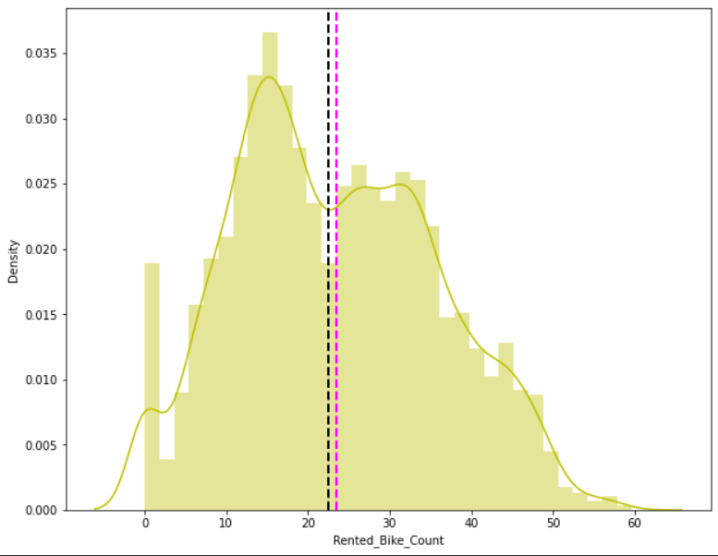
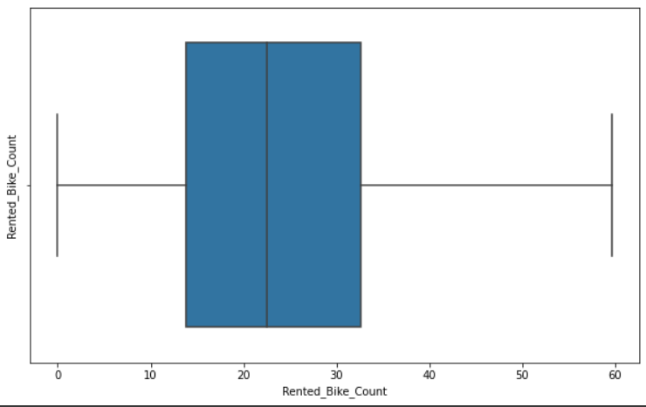
ANALYSIS OF RENTED BIKE COLUMN
➢ After applying Square root to the skewed Rented Bike Count,
here we get almost normal distribution.
➢ After applying Square root to the Rented Bike Count column, we
find that there is no outliers present

Slide 9
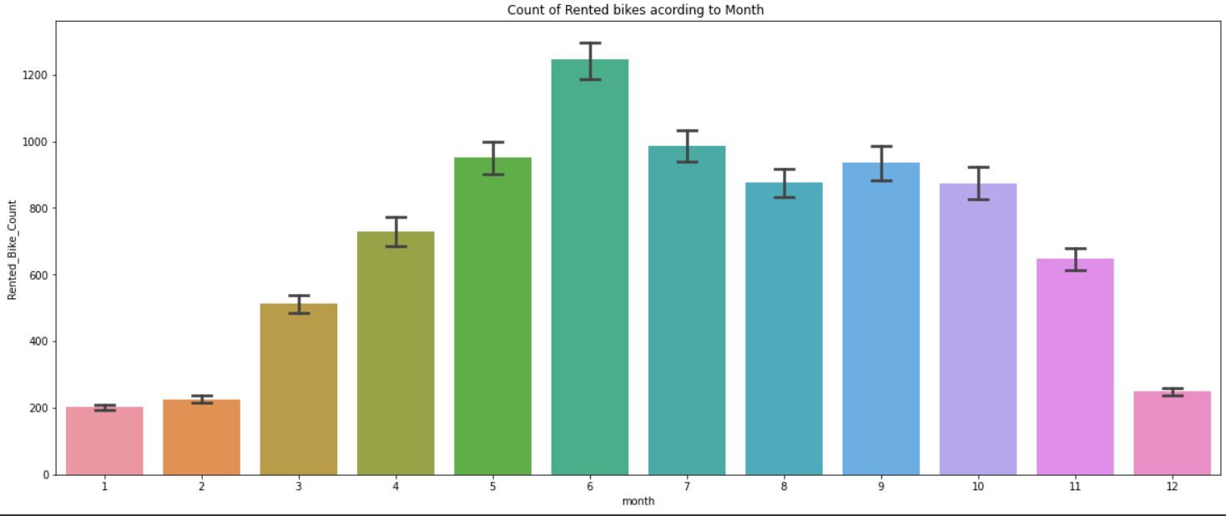
ANALYSIS OF MONTH VARIABLE
➢ From the above bar plot we can clearly say that from the month
5 to 10 the demand of the rented bike is high as compared to
other months. These months are coming inside the summer
season.

Slide 10
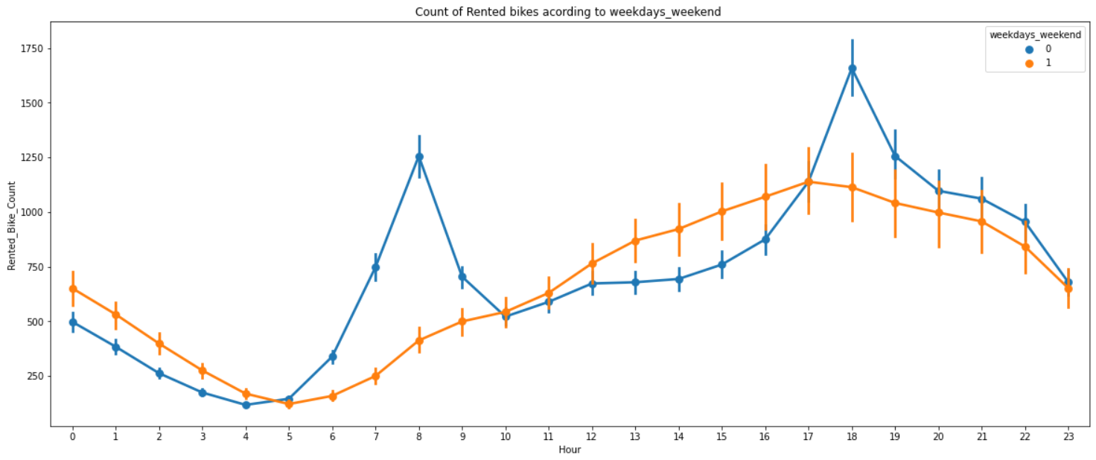
ANALYSIS OF WEEKDAYS_WEEKEND VARIABLE
From the above point plot and bar plot we can say that in the weekdays which represent in blue color show that the demand of the bike higher because of the office.
Peak Time are 7 am to 9 am and 5 pm to 7 pm
The orange color represent the weekend days, and it show that the demand of rented bikes are very low especially in the morning hour but when the evening start from 4 pm to 8 pm the demand slightly increases.

Slide 11
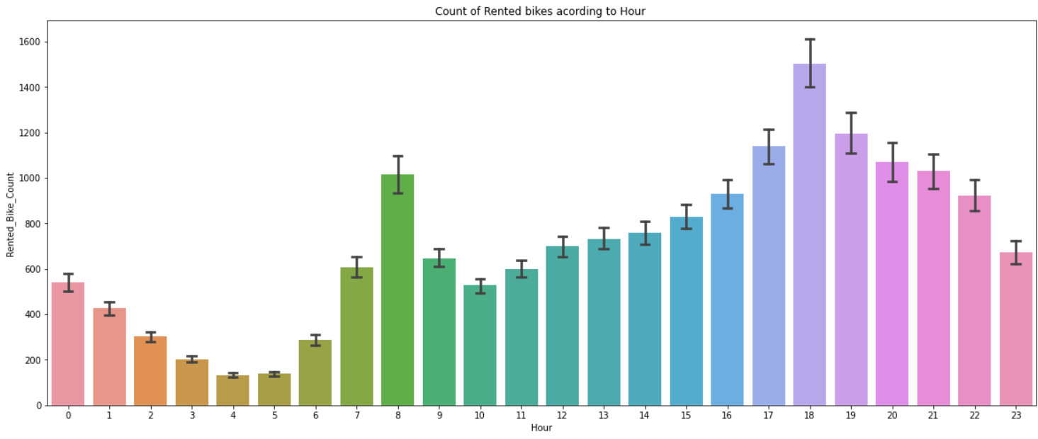
ANALYSIS OF HOUR VARIABLE
➢ In the above plot which shows the use of rented bike according
the hours and the data are from all over the year.
➢ generally people use rented bikes during their working hour
from 7am to 9am and 5pm to 7pm.

Slide 12
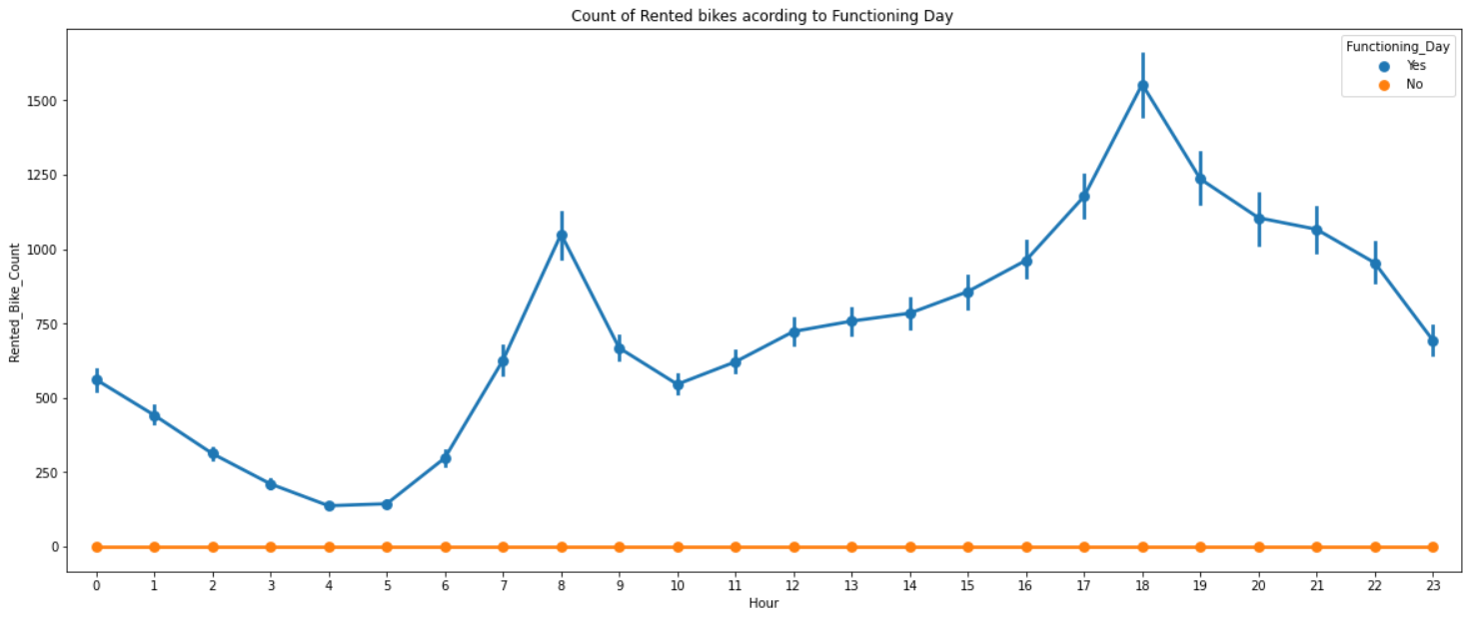
ANALYSIS OF FUNCTIONING DAY VARIABLE
➢ In the above point plot which shows the use of rented bike in
functioning day or not, and it clearly shows that,
➢ Peoples don't use rented bikes in no functioning day.

Slide 13
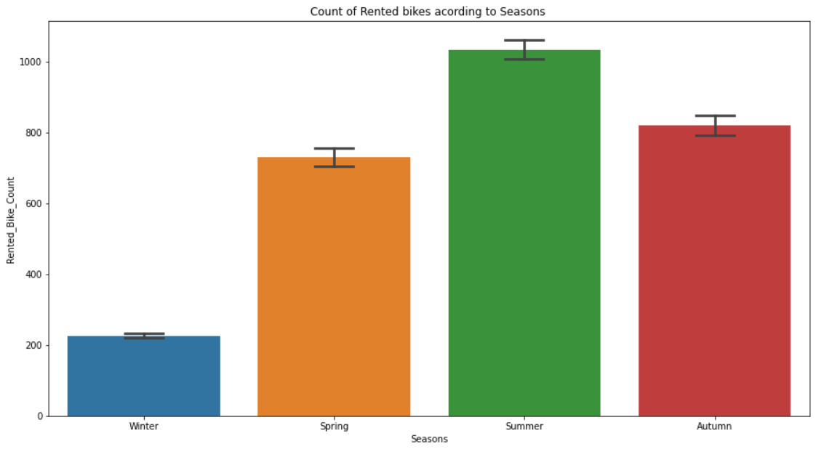
ANALYSIS OF SEASON VARIABLE
➢ This above bar plot shows the distribution of rented bike count season
wise
➢ And we can clearly see that that peoples love to ride bike in summer
seasons and autumn season
➢ But in winter season people don't take any rented bike due to because of
snowfall

Slide 14
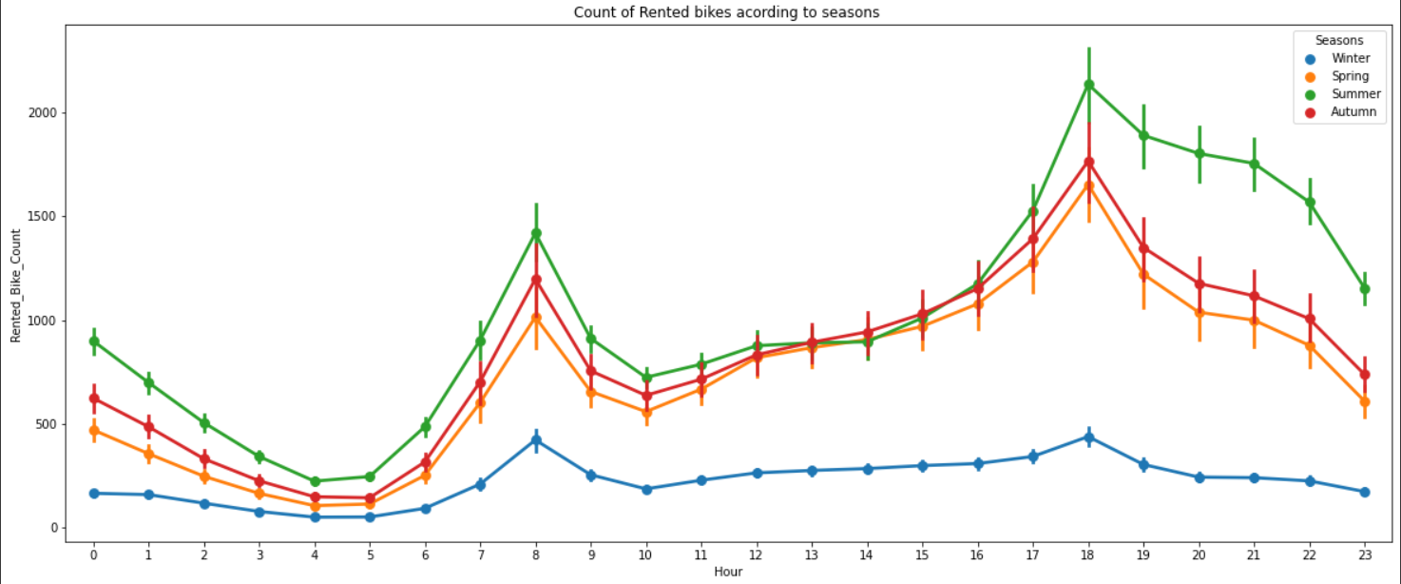
ANALYSIS OF SEASON VARIABLE
➢ In the above bar plot and point plot which shows the use of rented bike in
in four different seasons, and it clearly shows that,
➢ In summer season the use of rented bike is high and peak time is 7am
-9am and 7pm-5pm.
➢ In winter season the use of rented bike is very low because of snowfall

Slide 15
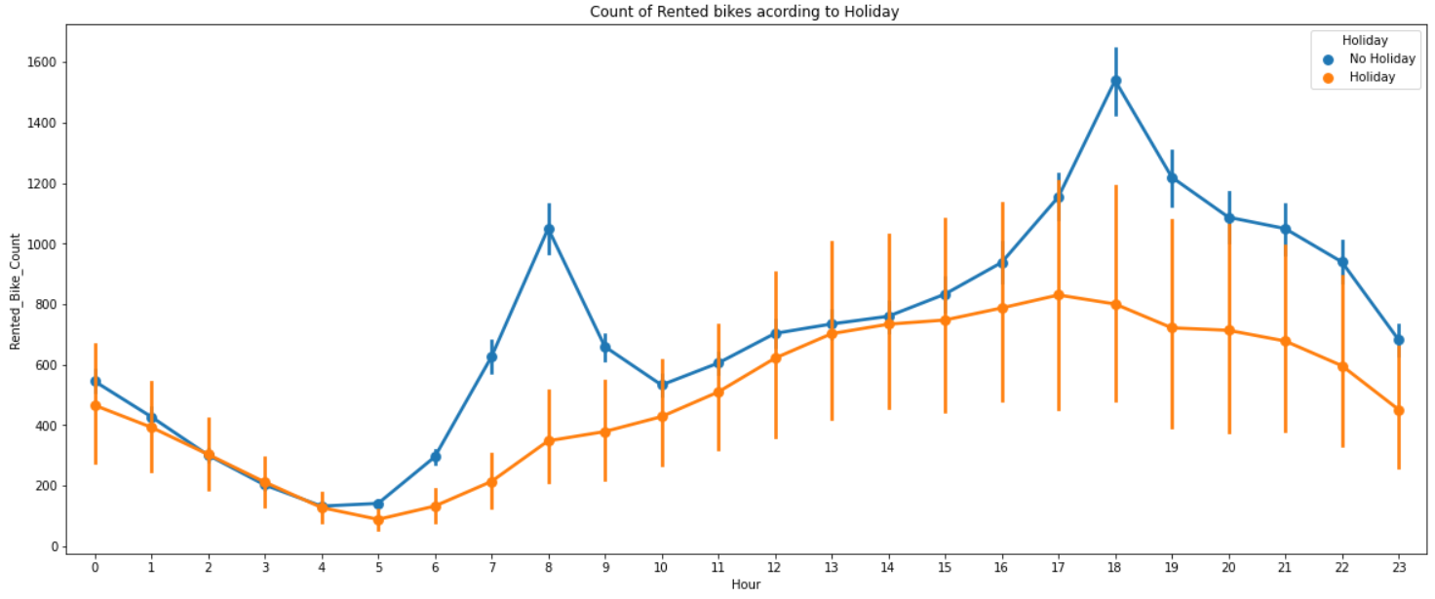
ANALYSIS OF HOLIDAY VARIABLE
➢ In the above bar plot and point plot which shows the use of
rented bike in a holiday,and it clearly shows that,
➢ plot shows that in holiday people uses the rented bike from 2pm
-8pm

Slide 16
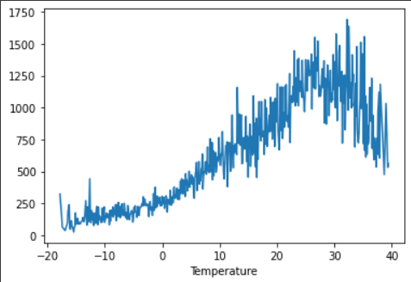
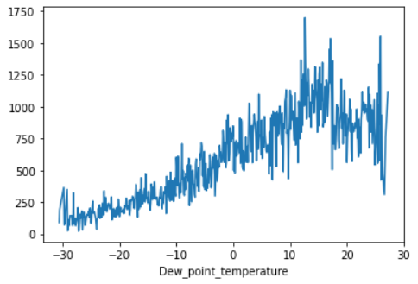
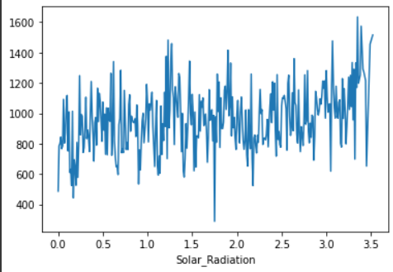
NUMERICAL VS.RENTED BIKE COUNT
➢ From the above plot we see that people like to ride bikes when it is pretty
hot around 25°C in average
➢ From the above plot of "Dew_point_temperature' is almost same as the
'temperature' there is some similarity present we can check it in our next
step
➢ from the above plot we see that, the number of rented bikes is huge,
when there is solar radiation, the counter of rents is around 1000

Slide 17
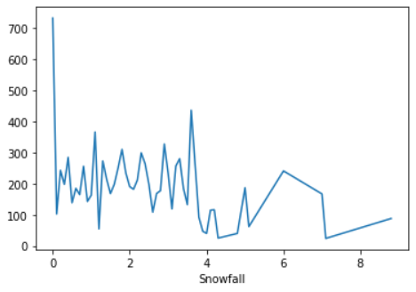
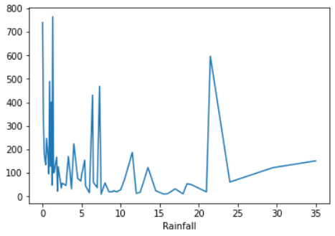
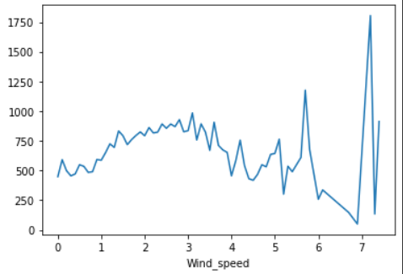
NUMERICAL VS.RENTED BIKE COUNT
In snowfall plot, on the y-axis, the amount of rented bike is very low When we have more than 4 cm of snow, the bike rents is much lower
In rainfall plot if it rains a lot the demand of rent bikes is not decreasing, here for
example even if we have 20 mm of rain there is a big peak of rented bikes
In wind speed plot that the demand of rented bike is uniformly distribute despite of wind speed but when the speed of wind was 7 m/s then the demand of bike also increase that clearly means peoples love to ride bikes when its little windy

Slide 18
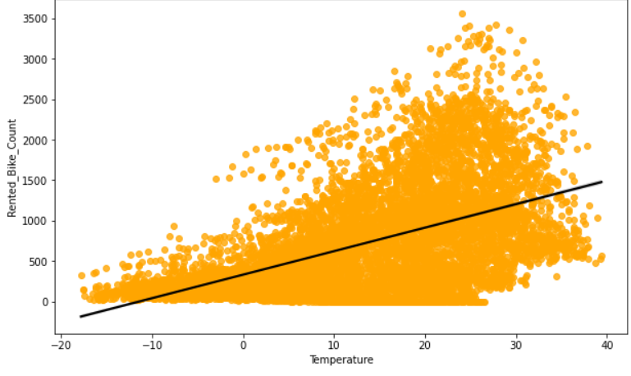
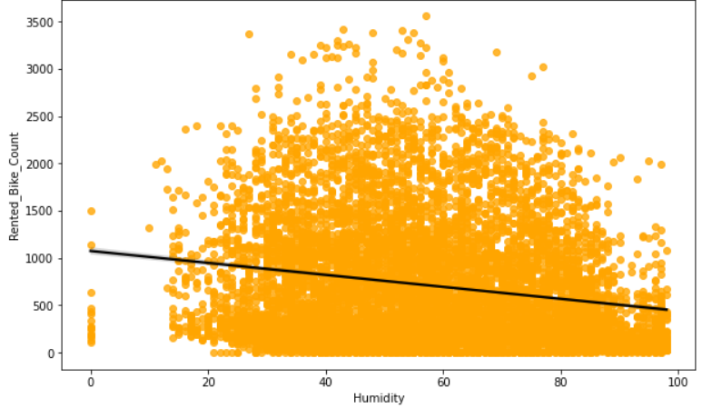
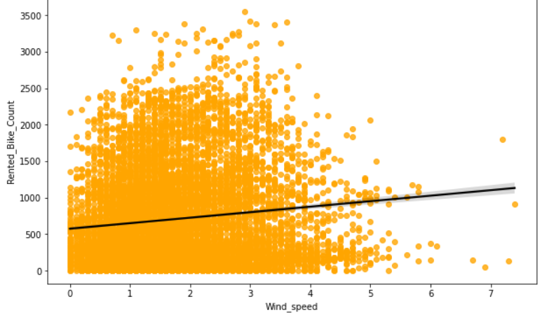
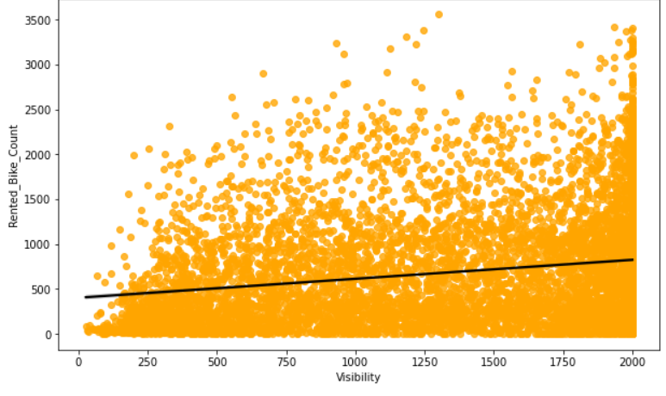
REGRESSION PLOT FOR NUMERICAL VARIABLE

Slide 19
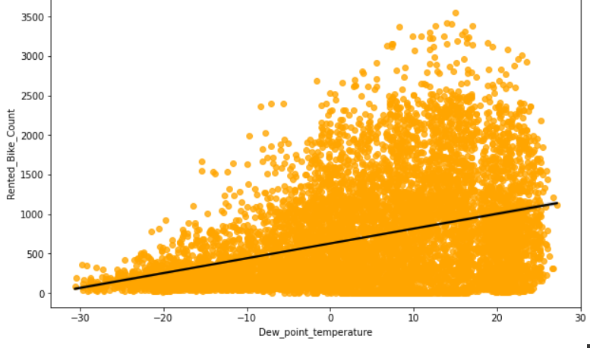
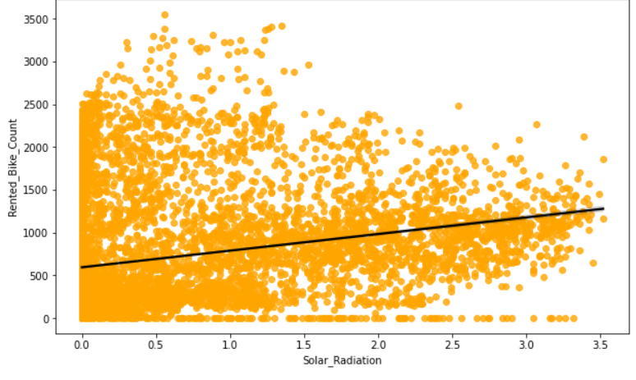
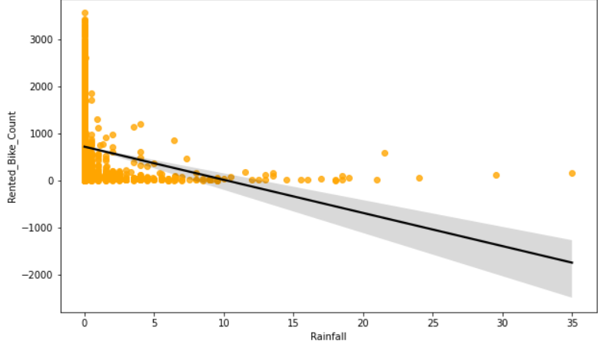
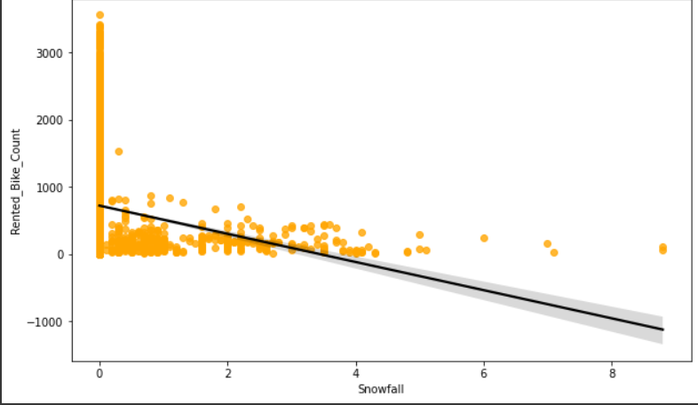
REGRESSION PLOT FOR NUMERICAL VARIABLE

Slide 20
REGRESSION PLOT FOR NUMERICAL VARIABLE
➢ From the above regression plot of all numerical features
we see that the columns 'Temperature', 'Wind_speed’,
'Visibility','Dew_point_temperature', 'Solar_Radiation' are
positively relation to the target variable.
➢ which means the rented bike count increases with
increase of these features.
➢ 'Rainfall','Snowfall','Humidity' these features are negatively
related with the target variable which means the rented
bike count decreases when these features increase.

Slide 21
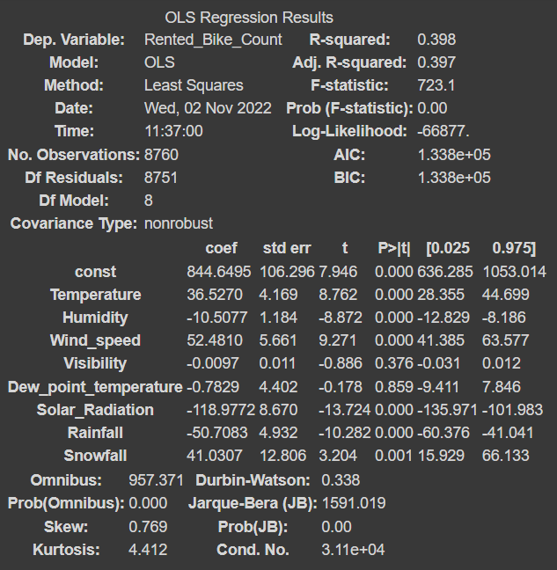
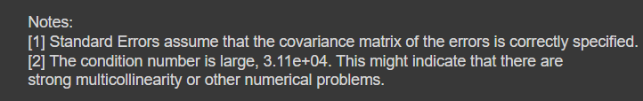
OLS REGRESSION MODEL
➢ R square and Adj Square are near
to each other. 40% of variance in
the Rented Bike count is
explained by the model.
➢ P value of dew point temp and
visibility are very high and they
are not significant.

Slide 22
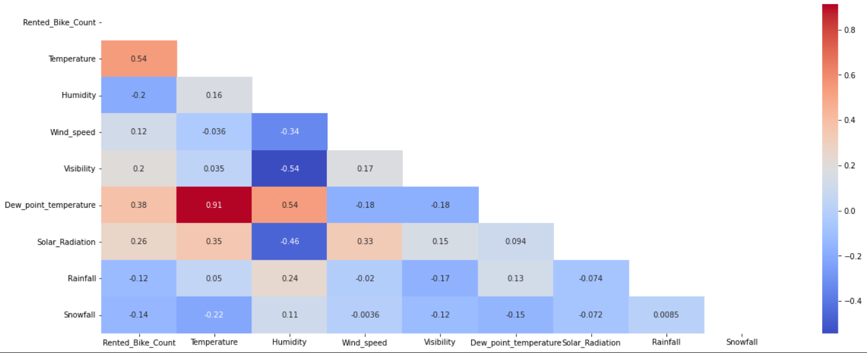
CORRELATION MATRIX
➢ Variables like Dew Point Temperature, and Temperature are
highly correlated.

Slide 23
MODEL BUILDING
➢ LINEAR REGRESSION
➢ LASSO REGRESSION
➢ RIDGE REGRESSION
➢ DECISION TREES REGRESSOR
➢ RANDOM FOREST REGRESSOR
➢ GRADIENT BOOSTED REGRESSOR
➢ GRADIENT BOOSTING REGRESSOR WITH
GRIDSEARCHCV

Slide 24
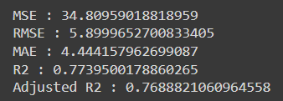
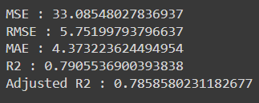
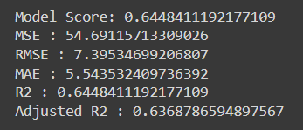
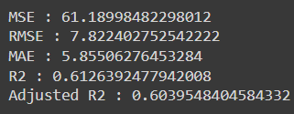
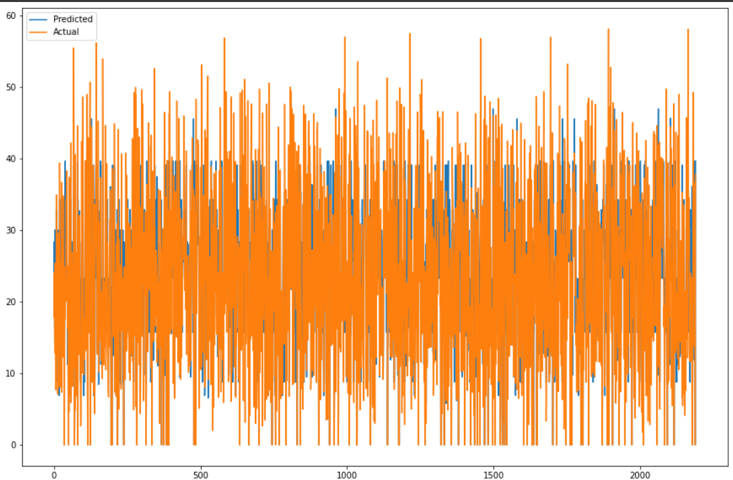
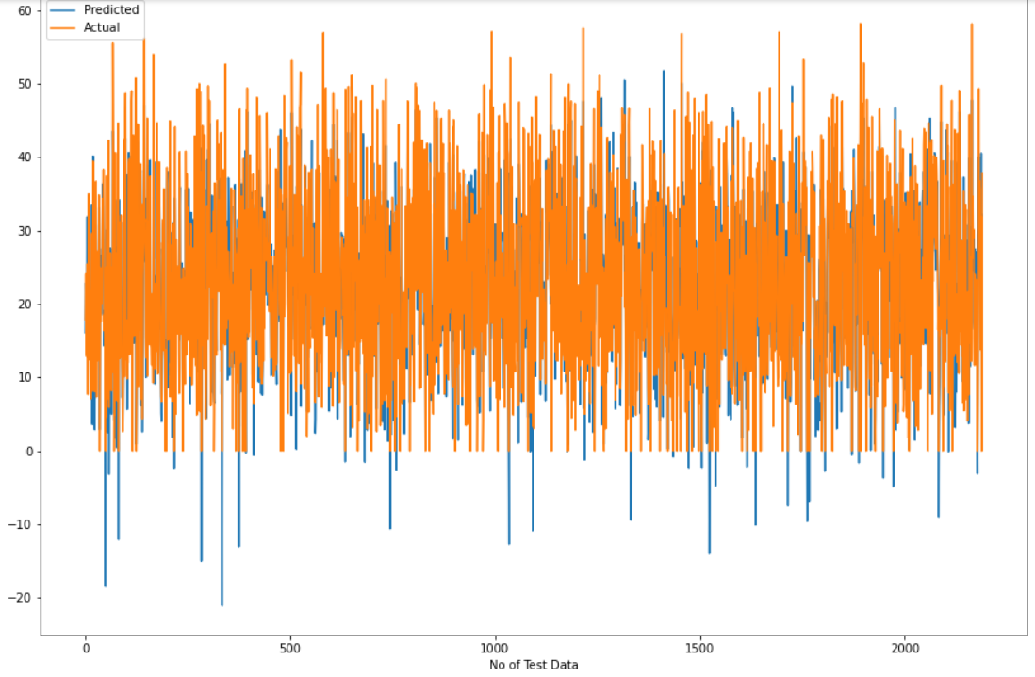
LINEAR REGRESSION DECISION TREE
Train Set Results Test Set Results
Train Set Results Test Set Results

Slide 25
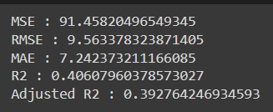
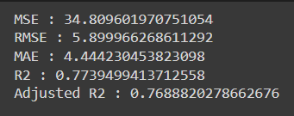
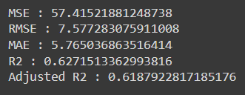
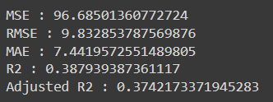
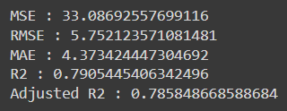
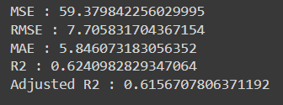
LASSO REGRESSION Train Set Results Test Set Results
RIDGE REGRESSION Train Set Results Test Set Results
ELASTIC NET REGRESSION Train Set Results Test Set Results

Slide 26
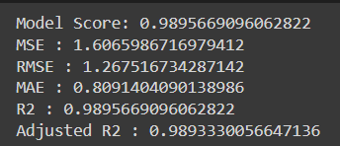
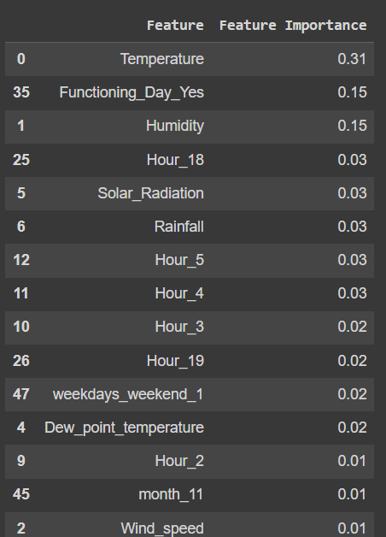
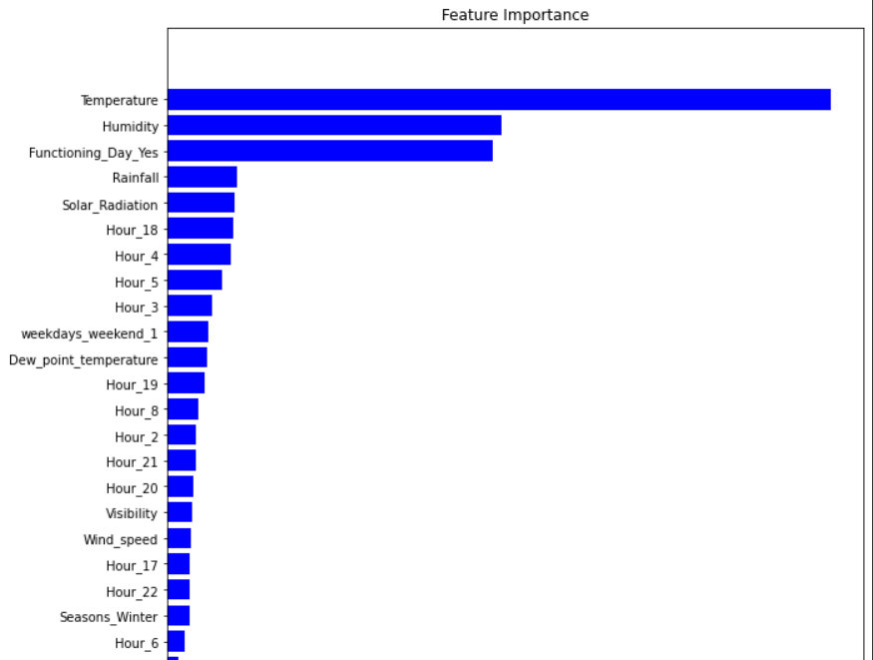
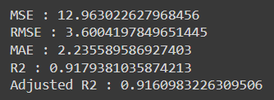
RANDOM FOREST
Train Set Results
Test Set Results

Slide 27
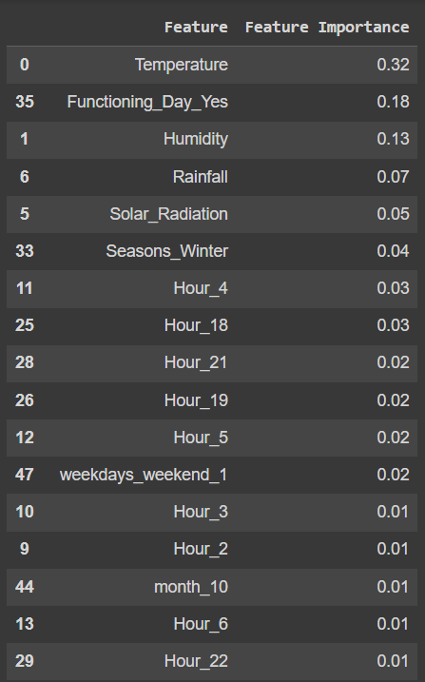
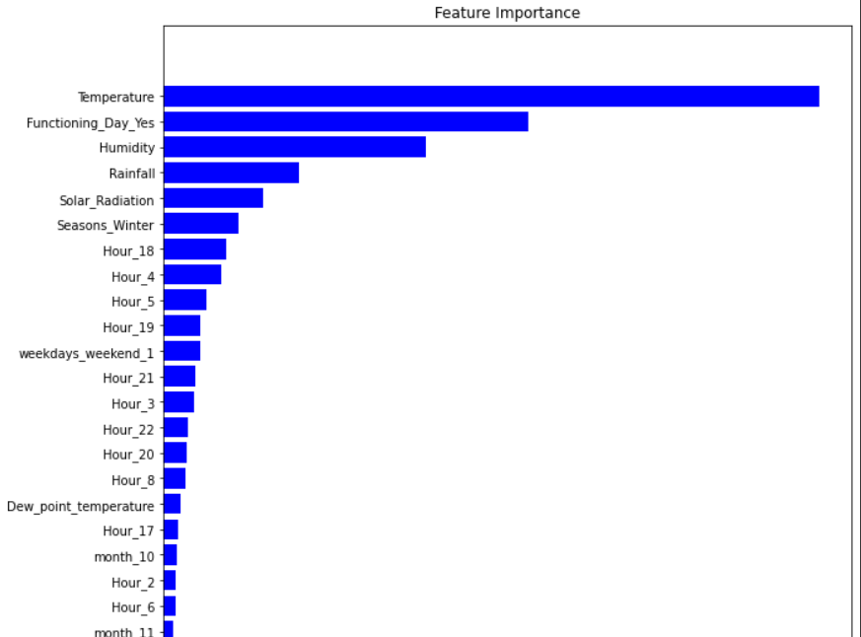
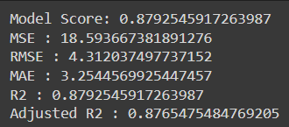
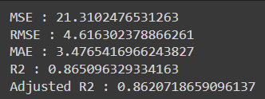
GRADIENT BOOSTING
Train Set Results
Test Set Results

Slide 28
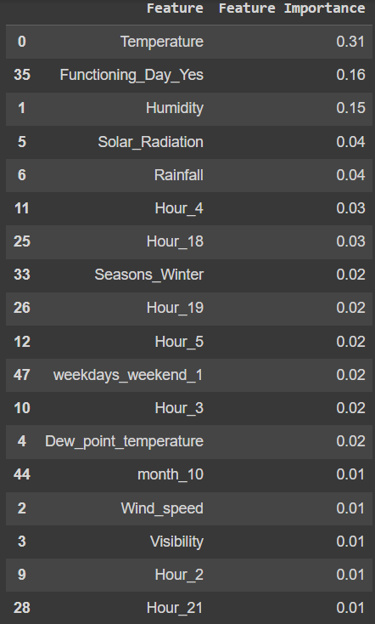




GRADIENT BOOSTING REGRESSOR WITH GRIDSEARCHCV
Train Set Results
Test Set Results
Hyper Parameter

Slide 29
CHALLENGES
➢ Large Dataset to handle.
➢ Needs to plot lot of Graphs to analyze.
➢ Feature engineering
➢ Feature selection
➢ Optimizing the model
➢ Carefully tuned Hyperparameters as it affects
the R2 score.

Slide 30
CONCLUSION
➢ ‘Hour’ of the day holds the most important feature.
➢ Bike rental count is mostly correlated with the time of the day as
it is peak at 10am morning and 8 pm at evening.
➢ We observed that bike rental count is high during working days
than nonworking day.
➢ We see that people generally prefer to bike at moderate to high
temperatures, and when little windy
➢ It is observed that highest number bike rentals counts in
Autumn & Summer seasons & the lowest in winter season. We
observed that the highest number of bike rentals on a clear day
and the lowest on a snowy or rainy day. We observed that with
increasing humidity, the number of bike rental counts decreases.

Slide 31


CONCLUSION
➢ When we compare the root mean squared error and mean absolute error
of all the models, Random forest Regressor and Gradient Boosting
gridsearchcv gives the highest R2 score of 99% and 95% respectively for
Train Set and 92% for Test set. So, finally this model is best for predicting
the bike rental count on daily basis.

Slide 32
Q&A

Slide 33
THANK YOU

